Slide 1
Revenge Travel
Savannah Roddey, K’den McMullin, Alex Lopez
Notes:
We researched online communities that partake in revenge travel. My name is…

Slide 2
Table of contents
01
02
03
04
05
06
07
Introduction
Methodology
Interviews
Literature Review
Data Analysis
Conclusion
Questions

Slide 3
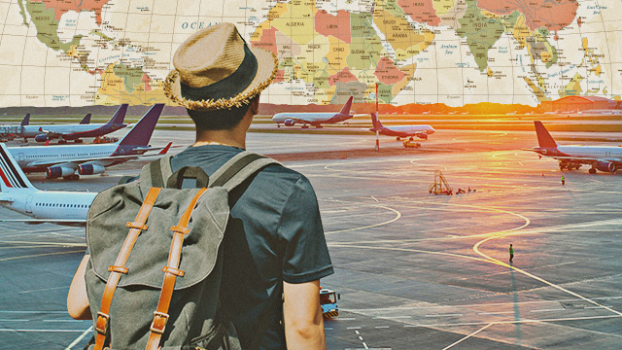
What is Revenge Travel?
Term for phenomenon of people embarking on extravagant trips to make up for lost time during Covid
Almost a third of US households went on a vacation between May and August
Gen Z and Millennials
Notes:
K’den

Slide 4
Literature Review
Amid the pandemic, a considerable number of individuals experienced psychological distress, particularly those who lost loved ones, leading to a significant impact on the sense of household security (Agrawal, pg 72).
Participants voiced concerns about an uncertain future but emphasized that this unpredictability should serve as a catalyst for proactive measures before it becomes too late. As a result, a sense of cautious optimism permeates their future travel plans (Y. Chen et al., 2022).
Experts are concerned that revenge travel may lead to the early onset of a third wave of COVID-19 (Dutta, 2021).
*References on Last Slide
Notes:
The aim of our project was to gain insight into the trends and motivations of people participating in revenge travel, the purpose of this literature review is to examine existing research and discussions surrounding this phenomenon. These quotes are representative of key points we found in a few of our papers.
Quote #3: This is important because this helps us gain insight into why people may react the way they do online towards those engaging in the phenomenon of Revenge Travel
Gaps in the finding:
The literature has helped gain info on certain aspects of revenge travel, however there are gaps in existing knowledge that our research aims to address. Our study seeks to contribute by shedding light on consumers perceptions while actively engaging in the trend and if those perceptions have been altered as a result of the pandemic. These remain underexplored so by doing this project, we hope to offer valuable insights into this and contribute to the ongoing phenomenon of revenge travel.

Slide 5

Methodology
Platform: Instagram, Reddit, Tiktok
System: 10am - 10pm
How did you conduct: Netnography and Conducting Interviews
How many posts: 10 each
Hashtags: #RevengeTravel
#RevengeTraveling
#revengetravel
#travel
r/Travel
Notes:
Alex

Slide 6
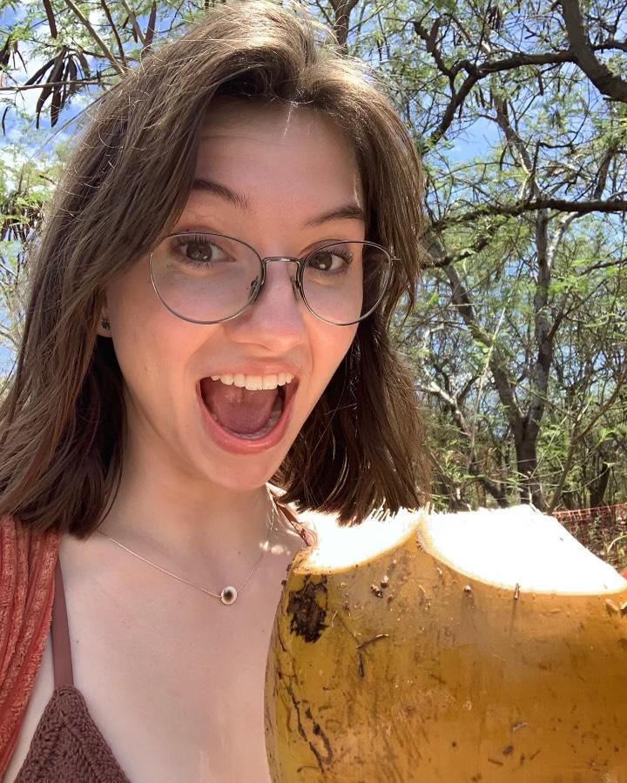
Interview #1
Interviewer | K’den
Interviewee Pseudonym | Eleanor
Length | 20:40
Date | 11/22/23
Notes:
Main findings:
-experienced a personality switch pre and post covid. Now her thoughts on travel are “you never know when it will be taken away so you need to take advantage of all the travel opportunities you get”
-has 4 small trips lined up over the next year. Feels super excited because there was such a long period of time where she was shutdown
-not too much planning involved in the trips. It's more on a whim, think of a place/opportunity comes up and within a week or so she decides if she is going or not

Slide 7
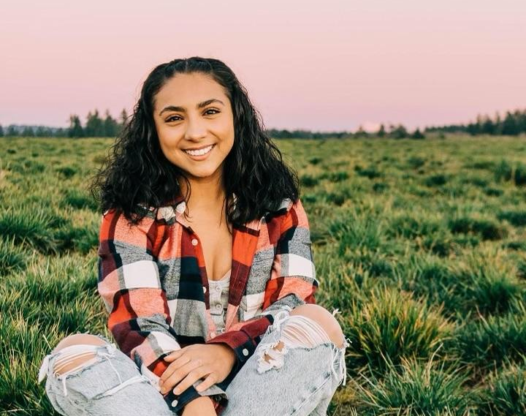
Interview #2
Interviewer | Alex Lopez
Interviewee Pseudonym | Veronica
Length | 31:57
Date | 11/13/23
Notes:
Main Findings - Has four dogs and two cats so time to travel wasn't very possible, but when she had the chance to travel she went big, going to chicago and mexico for a trip.
On the mexico trip she went with her family and everyone needed to get a negative covid test back in order for them to safely fly back.
With that one of her brothers got covid and all they could do is hope the airport covid test was negative.

Slide 8
Data Analysis

Slide 9
Open
Axial
“Covid Issues”
Selective
Negative Feeling Towards Covid
Political Views
Overwhelmed Emotions
No contact with others
Cautious about sudden rise of pandemic
Avoid lockdown restrictions
Reminisce
More time to connect
Reunion
Community
Spiritual
self-comfort
Rest/Relax
Mental Block
Anxious
Feeling Anxious
Overcoming Fear
“No stopping us”
Rebellion
“Tiring but fun”
Notes:
Alex (top 4)
Sav (middle 4)
K’den (bottom 4)

Slide 10
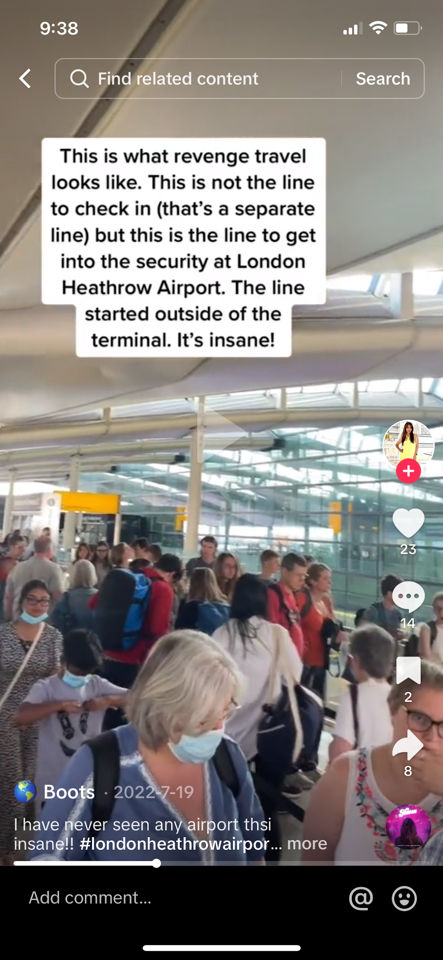
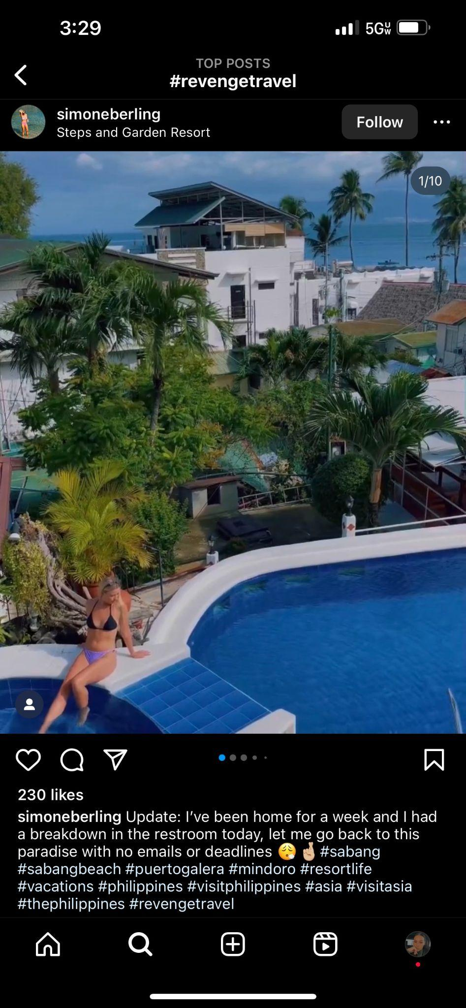
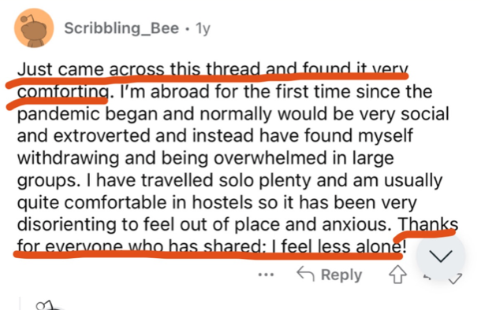
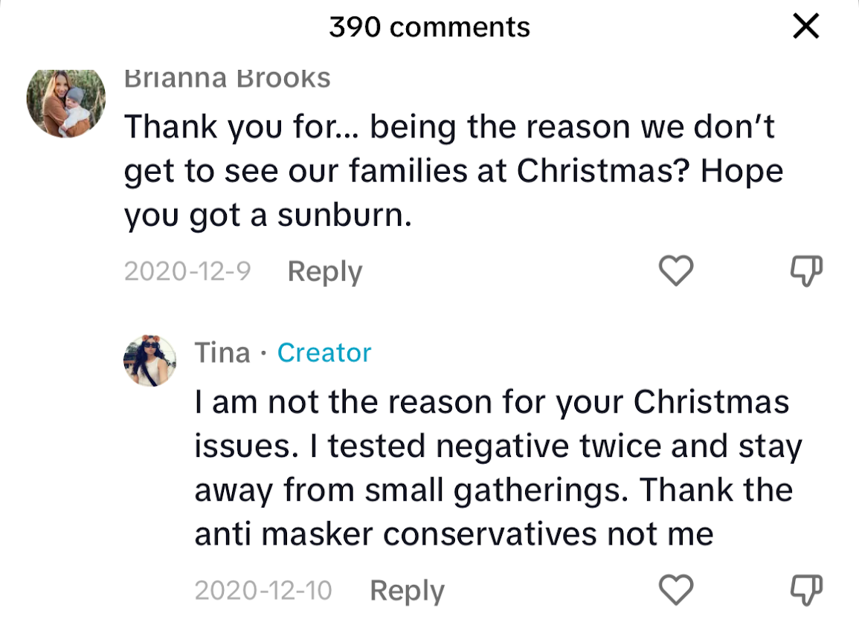
Overwhelmed Emotions
Notes:
Alex - notes → Choose the code then layer the pictures that represent it, we don’t have to choose just one screenshot, show like 5

Slide 11
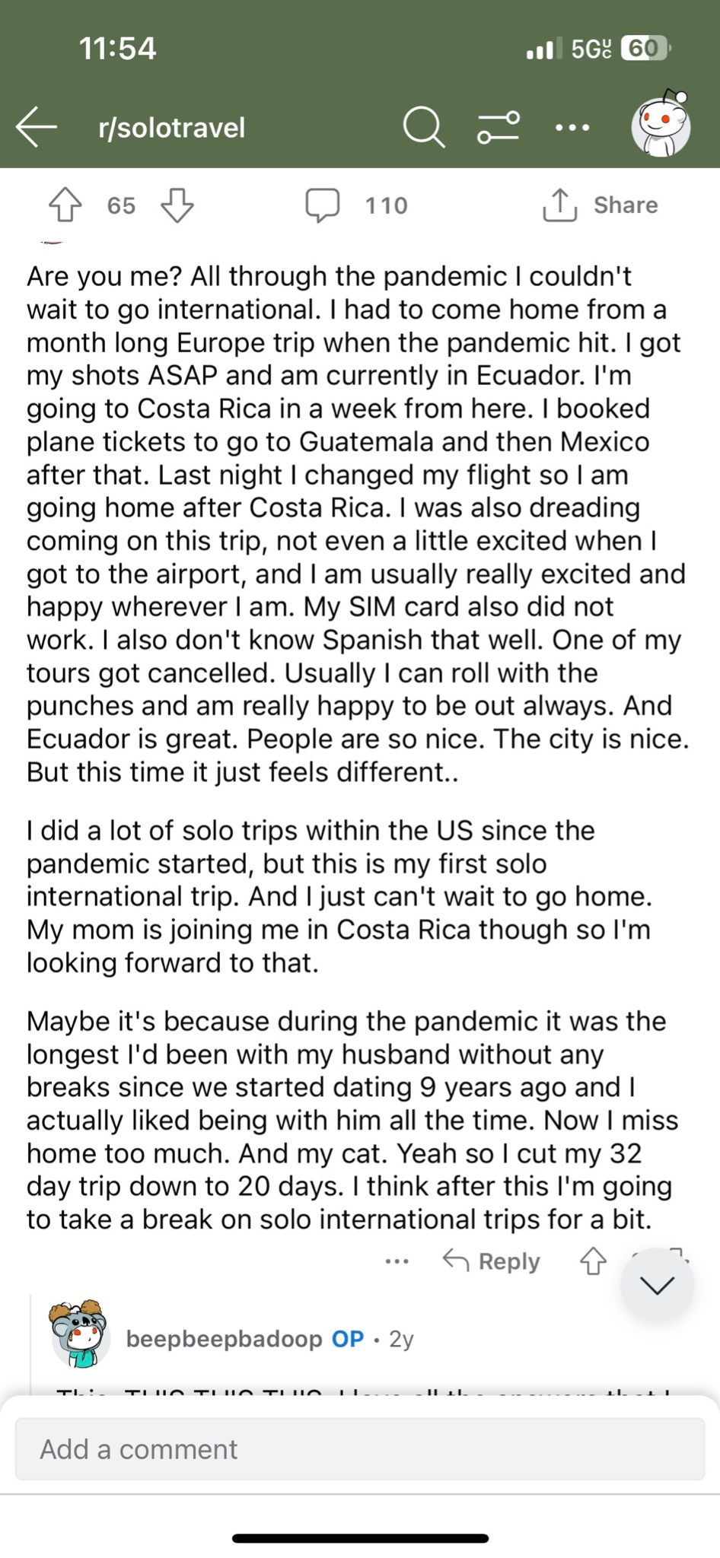
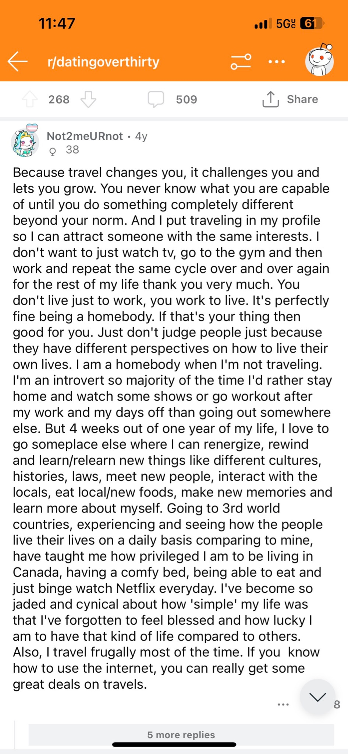
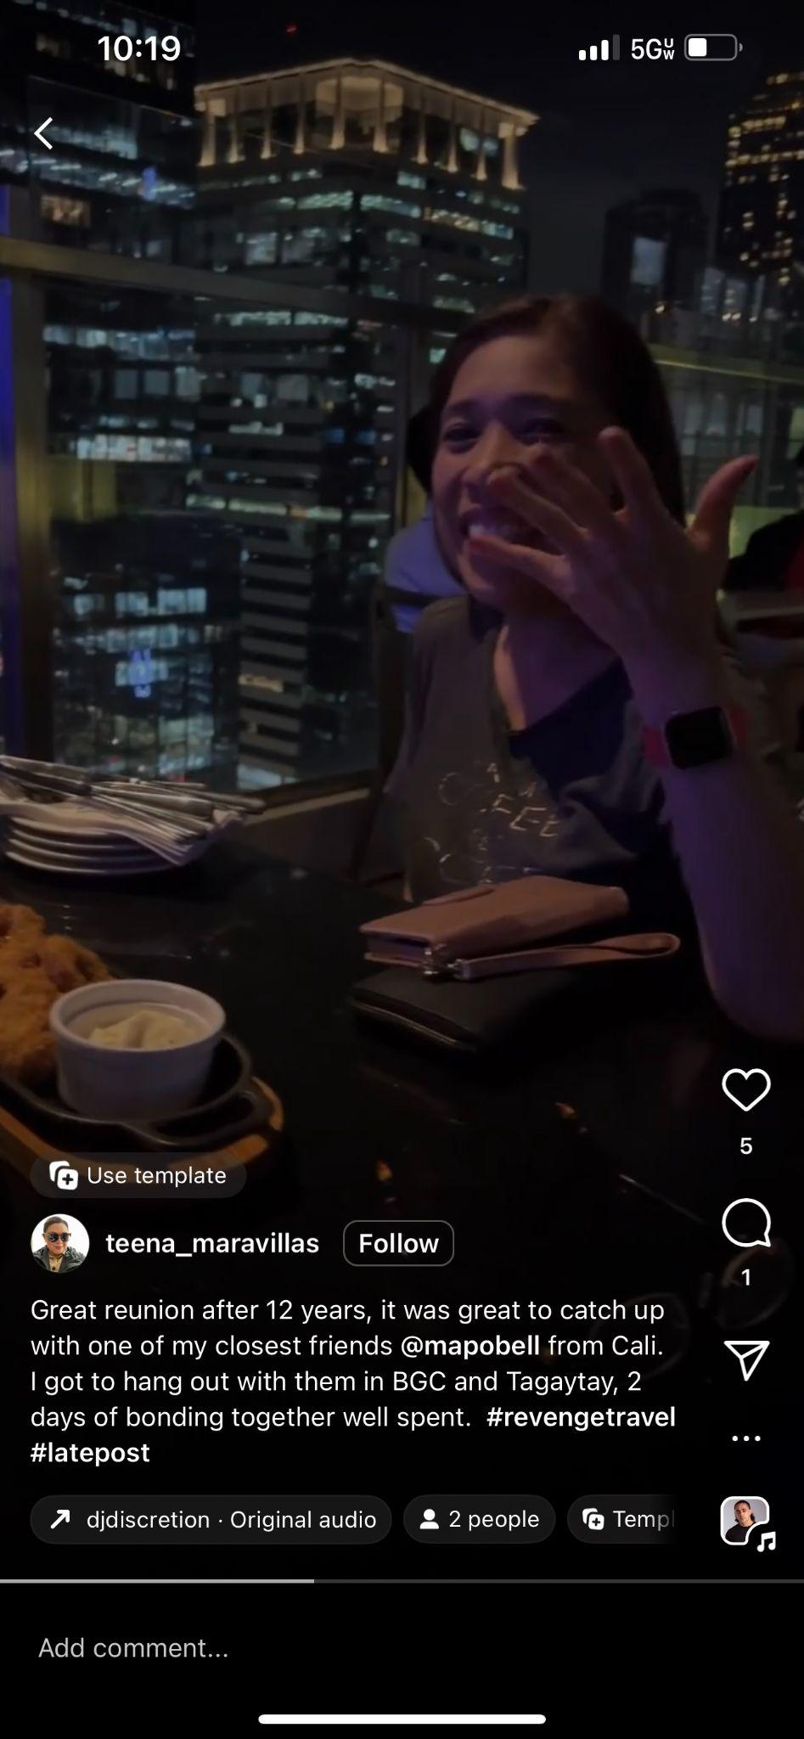
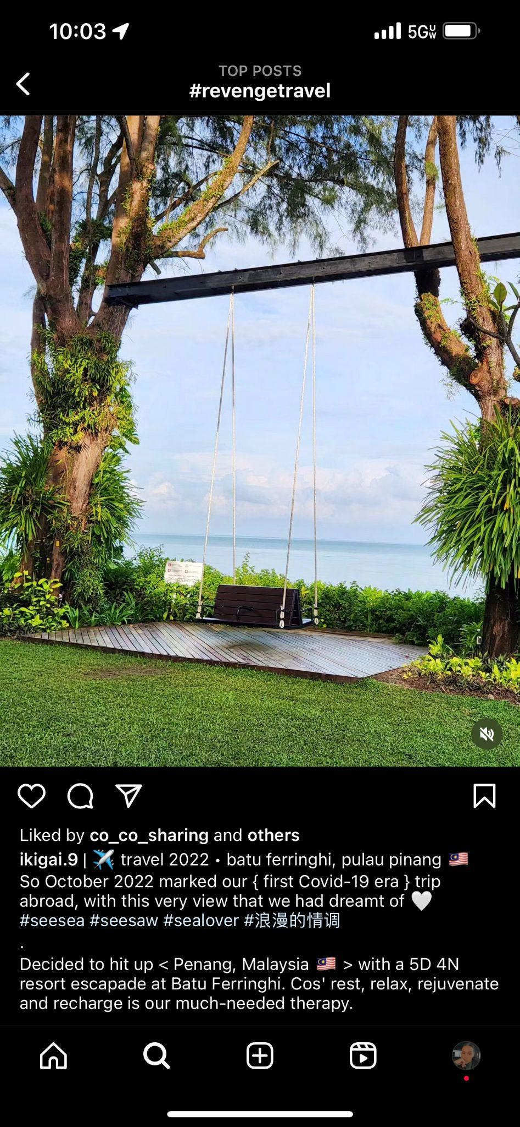
Community
Notes:
Sav

Slide 12
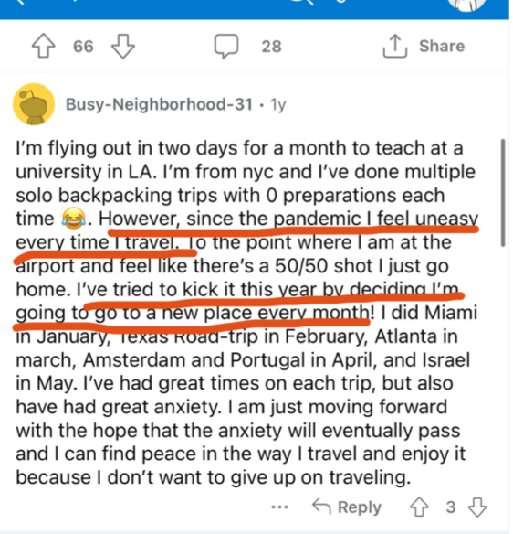
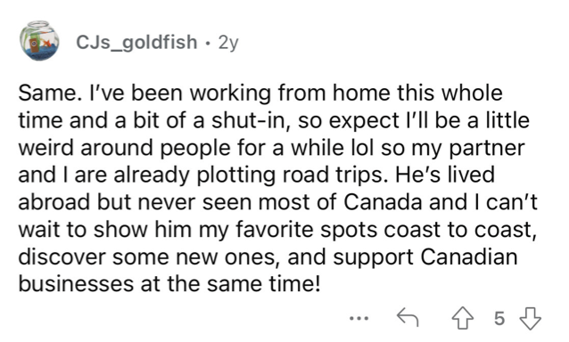
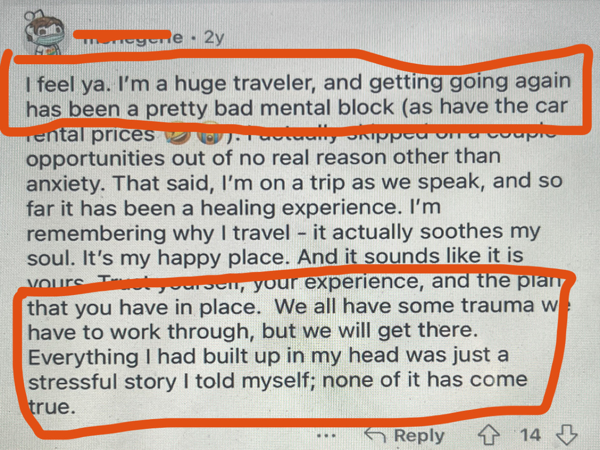
Overcoming Fear
Notes:
K’den

Slide 13
Conclusion
Our project has given us insight into the perceptions of individuals engaging in this phenomenon.
From our netnography to interviews, we interpreted that people were driven by a surge of overwhelmed emotions, a longing for a sense of community, and a profound feeling of overcoming fear as they embark on their travels.
Implications for Marketers
Using keywords when advertising airline tickets/ hotel bookings
  “Did Covid hold you back from taking your dream vacation? – Rediscover joy, reconnect with community, and conquer fears with our exclusive travel experiences.”
Notes:
Alex
Interesting insights, practical implications for marketers, how marketers can use this info? - With the rise of revenge travel, we see that people are starting to become more active and explore the outdoors more often. Switching this to see the bigger picture is that Marketers can focus more on being more creative on ways they advertise airline tickets/ hotel booking all the way down to managing someone else’s adventure. (and marketers can ask “did covid hold you back”

Slide 14
References
Agrawal, Charul. “Chapter 5, Revenge travel: A Case of Pandemic Fatigue and Boredom”, https://orcid.org/0000-0002-5471-8320 Amity University, India, viewtitlesample.aspx (igi-global.com)
Chen Y., Zhang Z., Wang T. (2022). Dire Straits: How tourists on the diamond Princess cruise endured the COVID-19 crisis. Tourism Management, 91. https://doi.org/10.1016/j.tourman.2022.104503
Dutta, S. (2021, July 25). 28% Indians plan to travel during Aug-Sept amid fear of Covid Third Wave: Report. Hindustan Times. https://www.hindustantimes.com/INDIA-NEWS/23-INDIANS-PLAN-TO-TRAVEL-DURING-AUG-SEPT-AMID-FEAR-OF-COVID-THIRD-WAVE-REPORT-101627229589624.HTML
Meenakshi, N., Dhir, A., Mahto, R. V., Nicolau, J. L., & Kaur, P. (2023). Travelers’ coping strategies in the backdrop of revenge tourism. Journal of Travel Research. https://doi.org/10.1177/00472875231193596

Slide 15
Thank you!
Savannah Roddey - rodd6415@pacificu.edu
K’den McMullin - mcmu8191@pacificu.edu
Alex Lopez - lope9109@pacificu.edu
Notes:
Maybe add “Any questions?”

